Slide 1
BOOKSTORE MANAGEMENT SYSTEM
Submitted By :
YASH GUPTA ( Roll NO:201500817)
ABHISHEK KUMAR SHARMA ( Roll NO: 201500021)
KRISHNA SARASWAT( Roll NO: 201500353)

Slide 2
PROJECT PROFILE
Project Definition : Bookstore Management System
Project Duration : 1 Months
Objective : To Computerize all the Book Details,
Manage Easily Details, Sell Books.
Project Guide : MR. VIKAS KUMAR.

Slide 3
SYSTEM ENVIRONMENT
Front End : HTML, CSS, BOOTSTRAP
Back End : PHP, MySQL
Tools & Technologies : Wamp Server,
MySQL Queries,
Browser (Mozila Firefox, Chrome..)
Text Editor(Sublime Text 3, Notepad ++..)

Slide 4
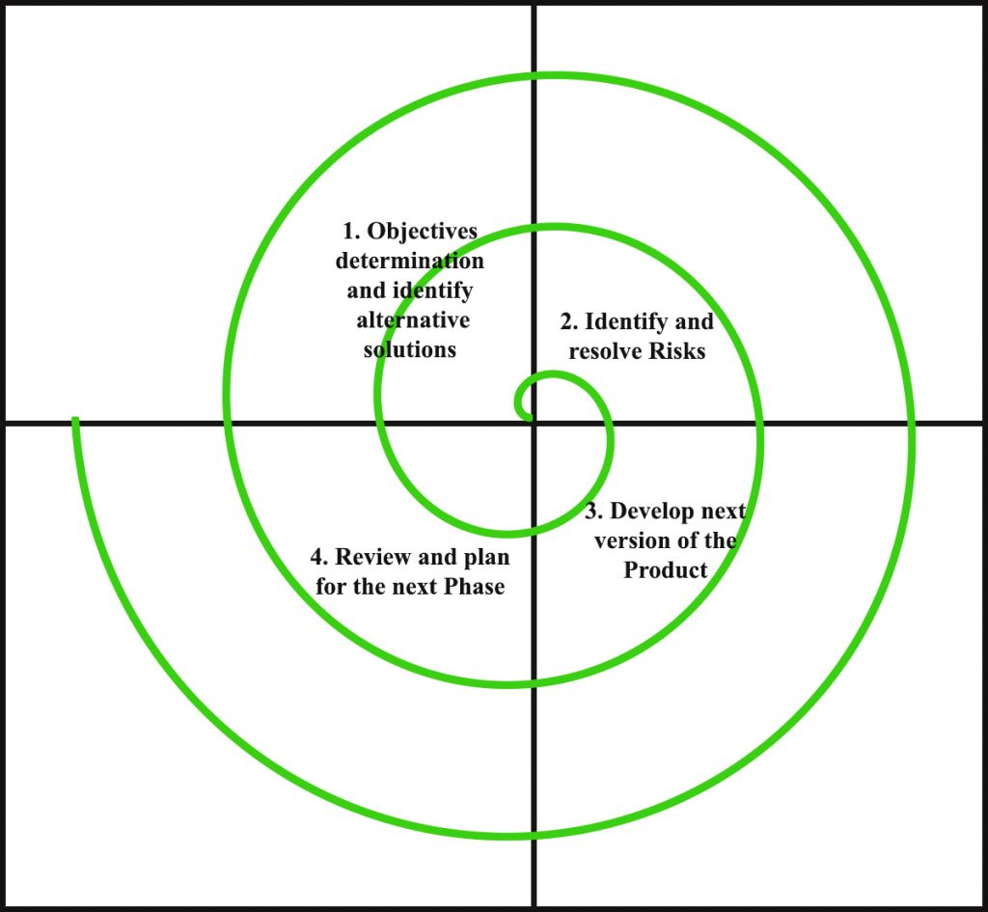
SYSTEM DEVELOPMENT STRATEGY
As per the requirement of the project, We have choose the Spiral as a strategy of developing the project, because in Spiral-SDLC model starts with a small set of requirement and goes through each development phase for those set of requirements, so the appropriate strategy is spiral model.

Slide 5
SYSTEM DESIGN
DATA DICTIONARY
DATA FLOW DIAGRAM
USE CASE DIAGRAM
ACTIVITY DIAGRAM
E-R DIAGRAM
SCREENSHOTS
TESTING AND IMPLEMENTATION
BIBLIOGRAPHY

Slide 6
DATA DICTIONARY
Database BMS Contains Following Tables:
Admin
Book
Category
Contact
Register
Order

Slide 7
Table Name : Admin
Primary Key : A_id
Description : Store Admin Details
Field | Type | Size | Description
A_id | Int | 4 | Admin ID [Auto Increment]
A_unm | Varchar | 3 | Username of Admin
A_pwd | Varchar | 30 | Password of Admin

Slide 8
Table Name : Book
Primary Key : B_id
Description : Store Book Details
Field | Type | Size | Description
B_id | Int | 10 | Book ID [Auto Increment]
B_nm | Varchar | 50 | Book Name
B_cat | Int | 6 | Select or Store Book ID of Different Categories
B_desc | Longtext |  | Description of Book
B_price | Int | 4 | Price of Book
B_img | Varchar | 50 | Image Name of Book
B_time | Int | 20 | Time of Inserted book

Slide 9
Table Name : Category
Primary Key : Cat_id
Description : Store Book Category Details
Field | Type | Size | Description
Cat_id | Int | 10 | Category ID [Auto Increment]
Cat_nm | Varchar | 50 | Category Name

Slide 10
Table Name : Contact
Primary Key : C_id
Description : Store Contacted Person Details
Field | Type | Size | Description
C_id | Int | 4 | Contact ID [Auto Increment]
C_fnm | Varchar | 100 | Full Name of User
C_mno | Int | 10 | User Mobile Number
C_email | Varchar | 60 | User E-Mail Address
C_msg | Longtext |  | User Message or Query
C_time | Varchar | 20 | Time of Send Message

Slide 11
Table Name : Register
Primary Key : R_id
Description : Store Register Details
Field | Type | Size | Description
R_id | Int | 8 | Regiser ID [Auto Increment]
R_fnm | Varchar | 100 | Full Name for User
R_unm | Varchar | 50 | Username for User
R_pwd | Varchar | 30 | Password for User
R_cno | Varchar | 10 | Contact Number for User
R_email | Varchar | 60 | E-Mail Address for User
R_time | Varchar | 20 | Registration Time of User

Slide 12
Table Name : Order
Primary Key : O_id
Description : Store Order Details
Field | Type | Size | Description
O_id | Int | 11 | Order ID [Auto Increment]
O_name | Varchar | 30 | Full Name of Client
O_address | Varchar | 200 | Address of Client
O_pincode | Int | 20 | City Pincode of Client
O_city | Varchar | 30 | City Name of Client
O_state | Varchar | 30 | State Name of Client
O_mobile | Int | 20 | Mobile Number of Client
O_rid | Int | 8 | Register ID of User

Slide 13
DATA FLOW DIAGRAM
List of
Category
Select from
Categories
category
User
Required
Book Details
Select from
Books
information
books
Add to
cart
Order Details
Submit Order
-
User Details
Order Details
Successfully Placed

Slide 14
USE CASE DIAGRAM
BOOKSTORE MANAGEMENT SYSTEM
View Books
Order
User
Login
Add to Cart
Admin
Register
Add Cat, Books
Visitor
Delete Cat, Books
Delete User

Slide 15
ACTIVITY DIAGRAM
Home Page
View Books
Select Book
Book Detail
Add to Cart
Is a Member
Login
No
Yes
Register
Added to Cart
Submit Order
Order Placed

Slide 16
E-R DIAGRAM
city
e-mail
password
con-no
name
date
id
Customers
Buys
id
name
name
image
id
price
BMS Contains
qty
Cart
Books
image
price
Cat..
Has Many
desc
Category
id
name

Slide 17
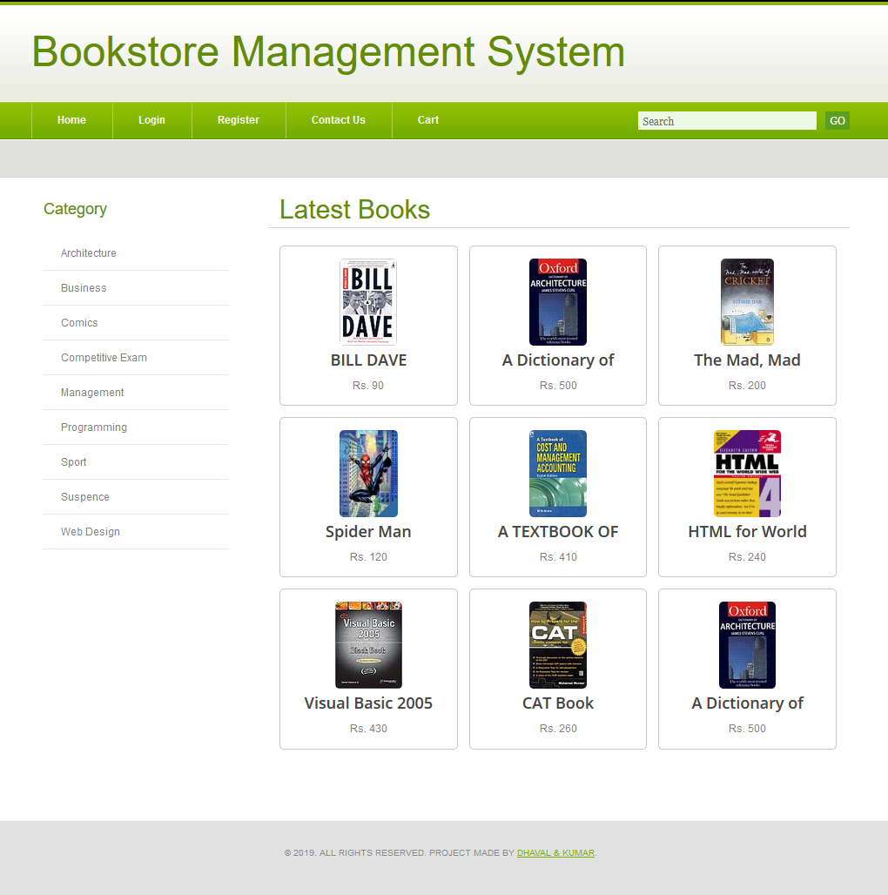
SCREENSHOTS
Home Page

Slide 18
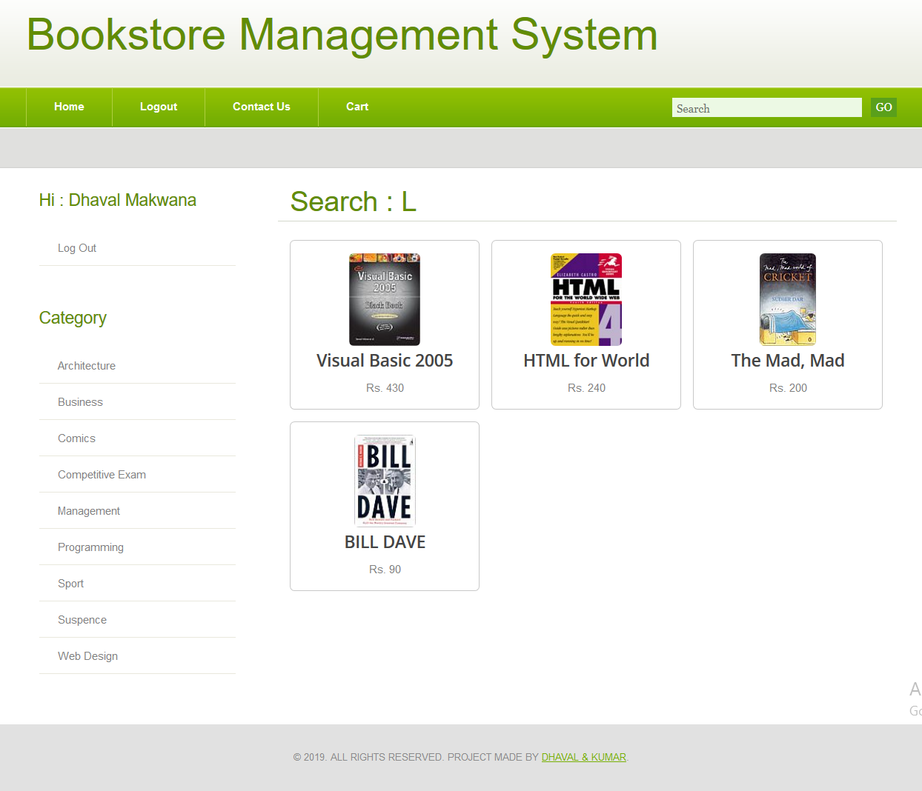
Search Books : L

Slide 19
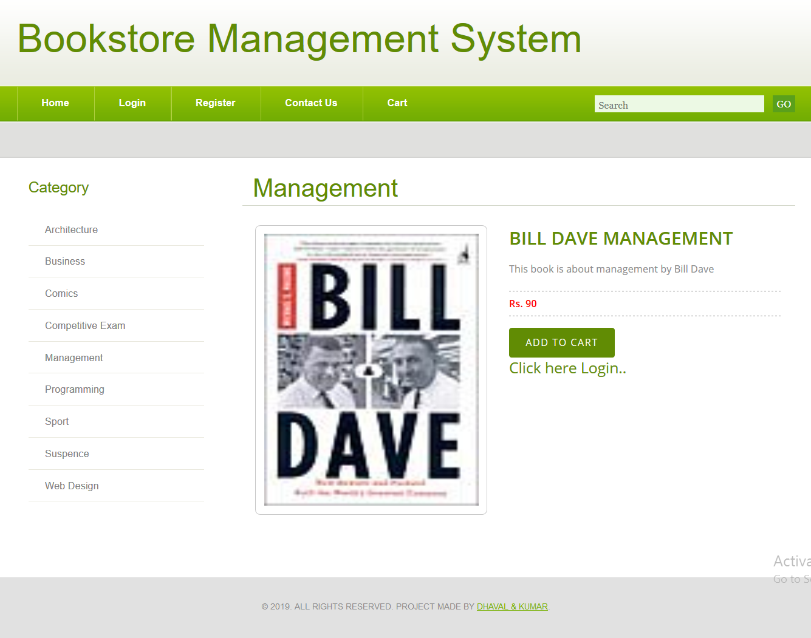
Book Detail
Login Required for Add To Cart

Slide 20
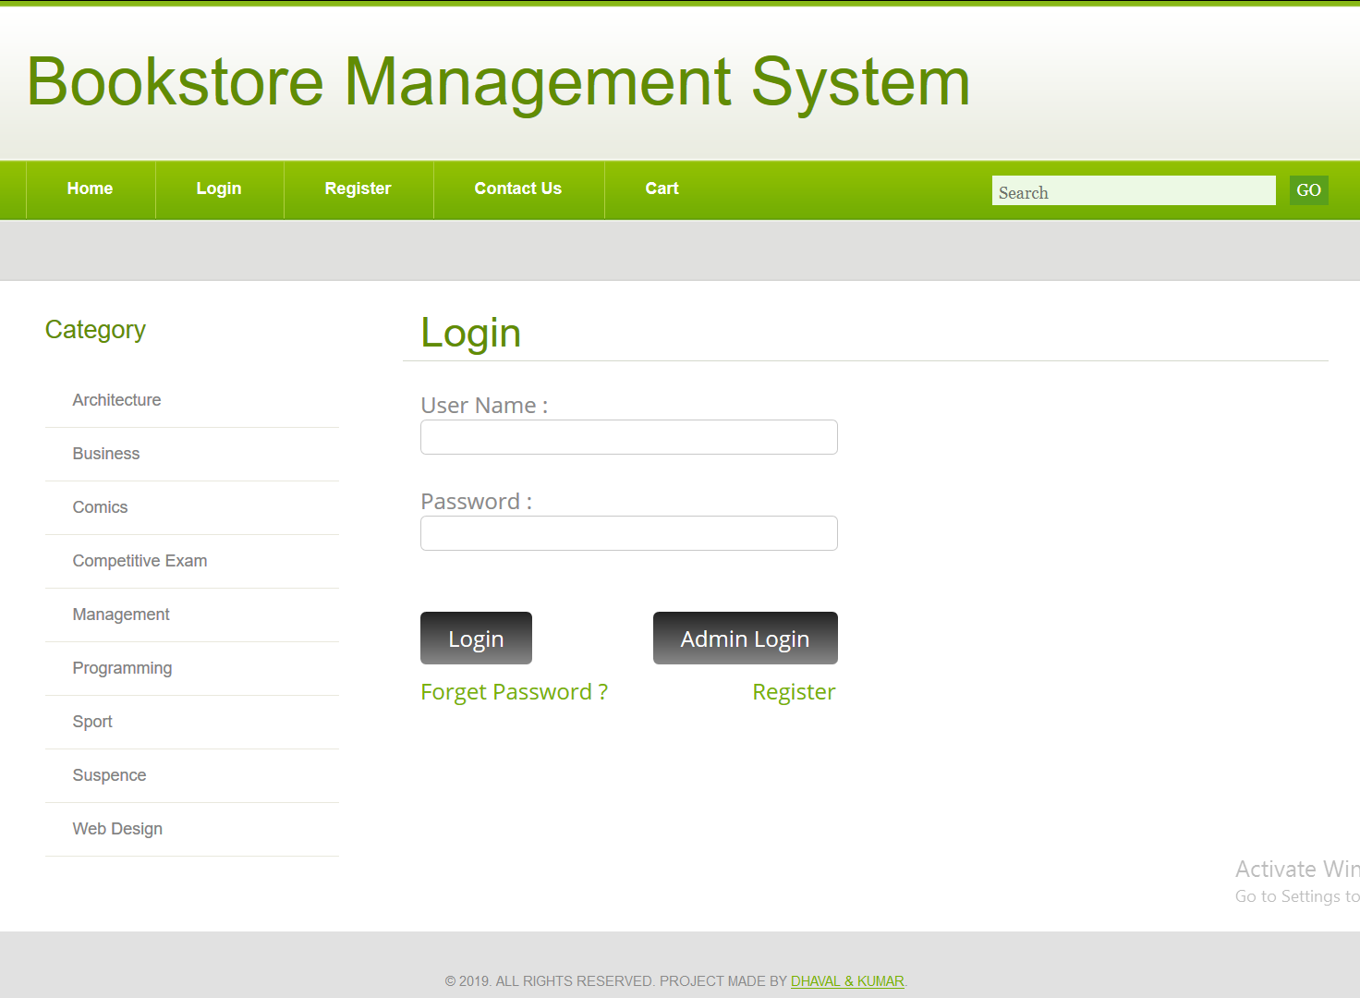
Login Form

Slide 21
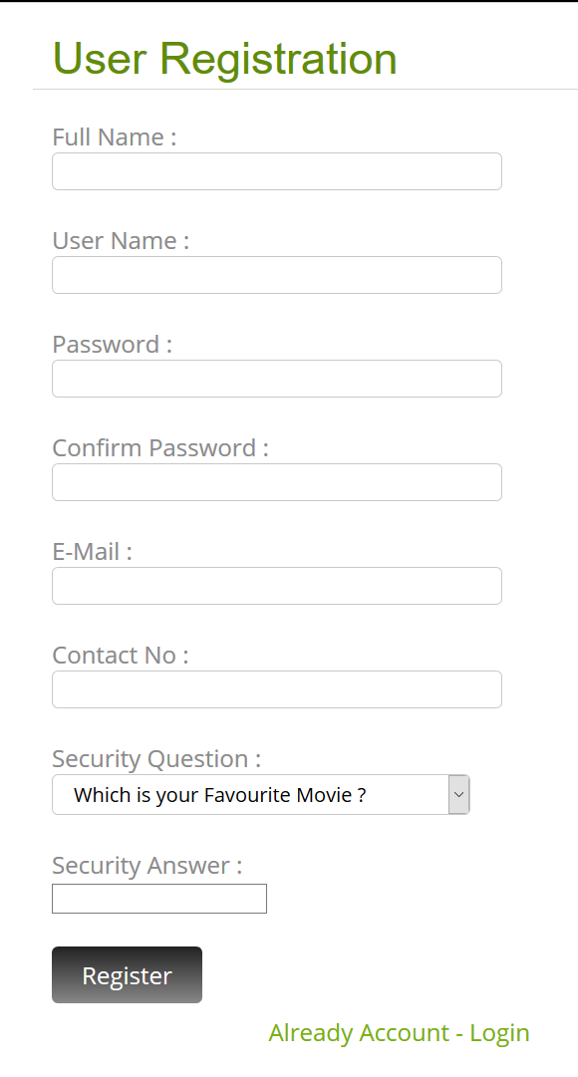
Register Form

Slide 22
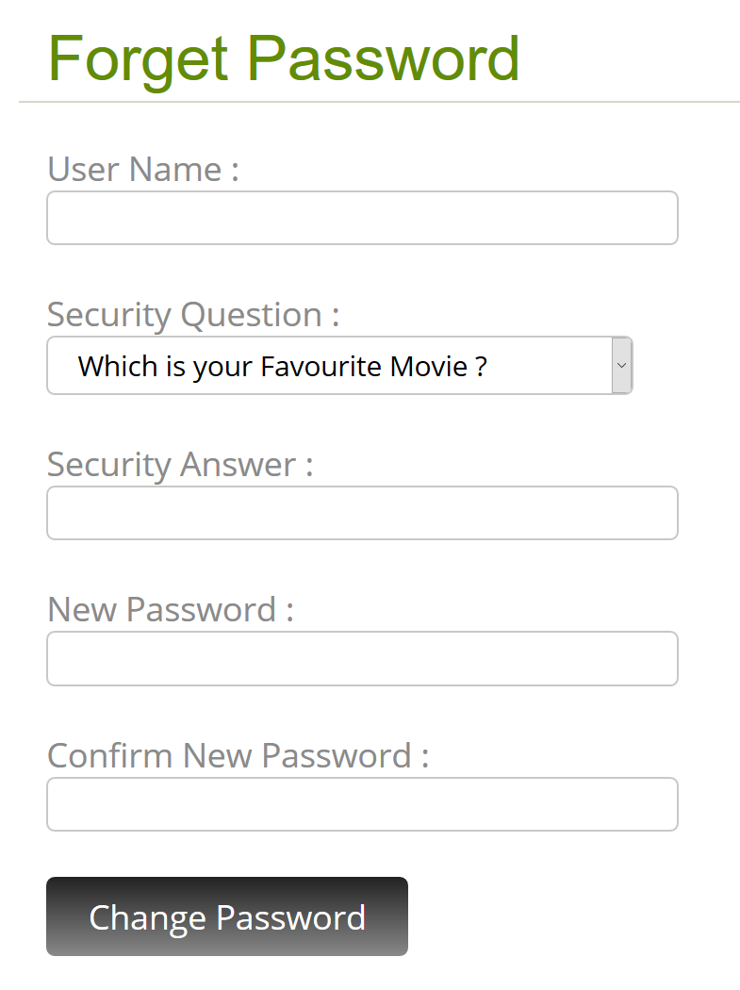
Forget Password

Slide 23
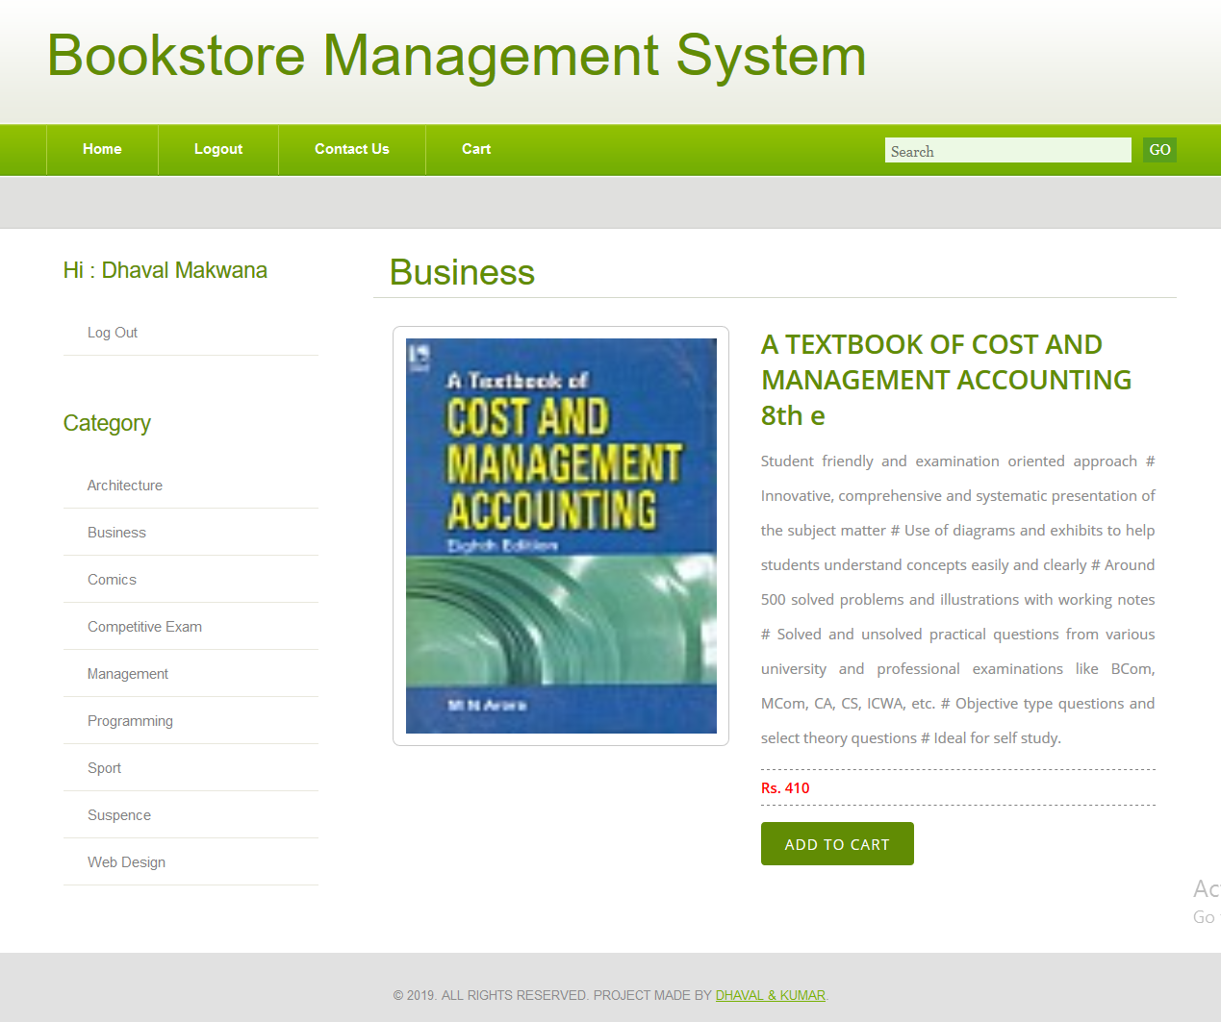
User Detail Page

Slide 24
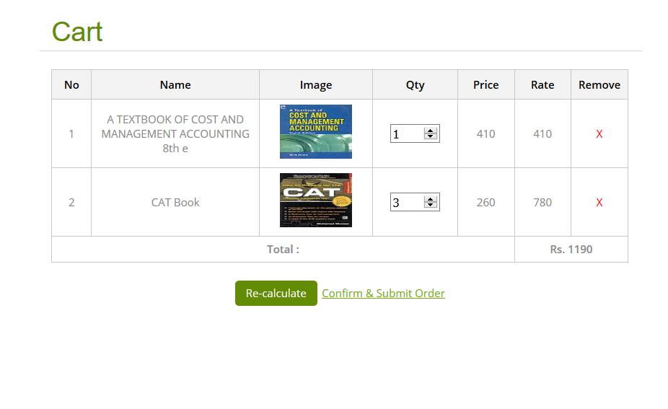
Cart Page
Re-Calculate
Qty, Rate & Total
Order

Slide 25
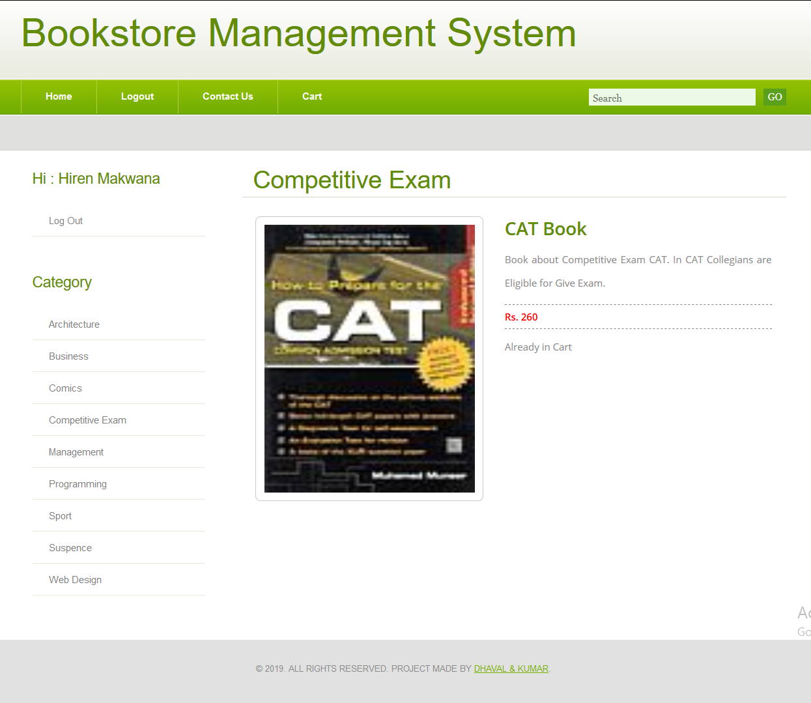
Already in Cart
Already in Cart

Slide 26
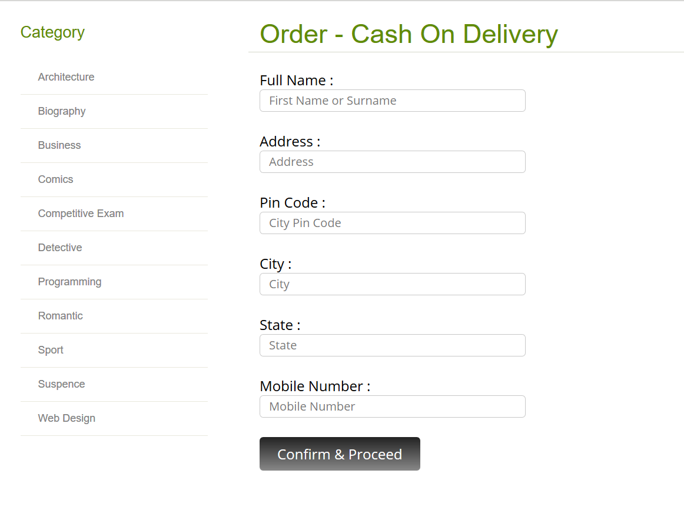
Order Page

Slide 27
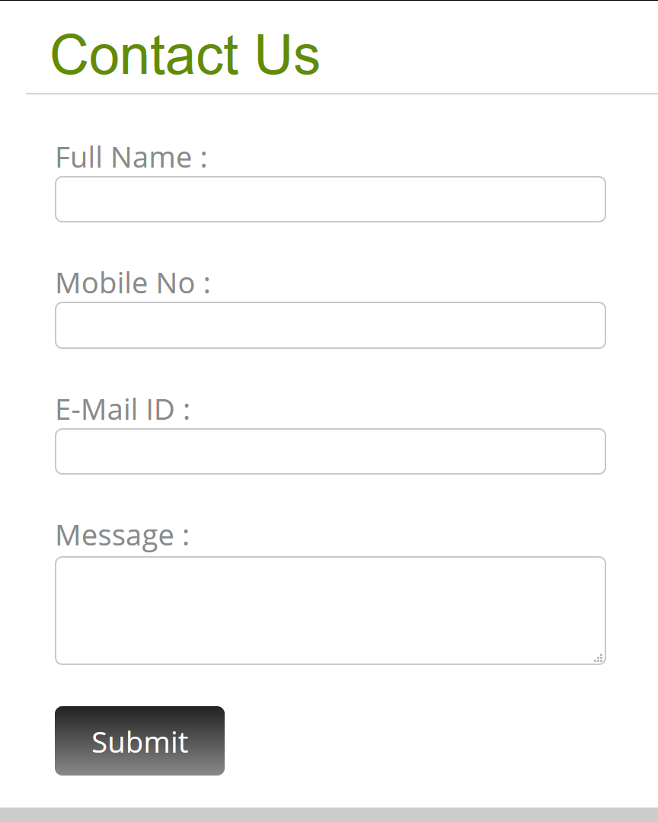
Contact Us Form

Slide 28
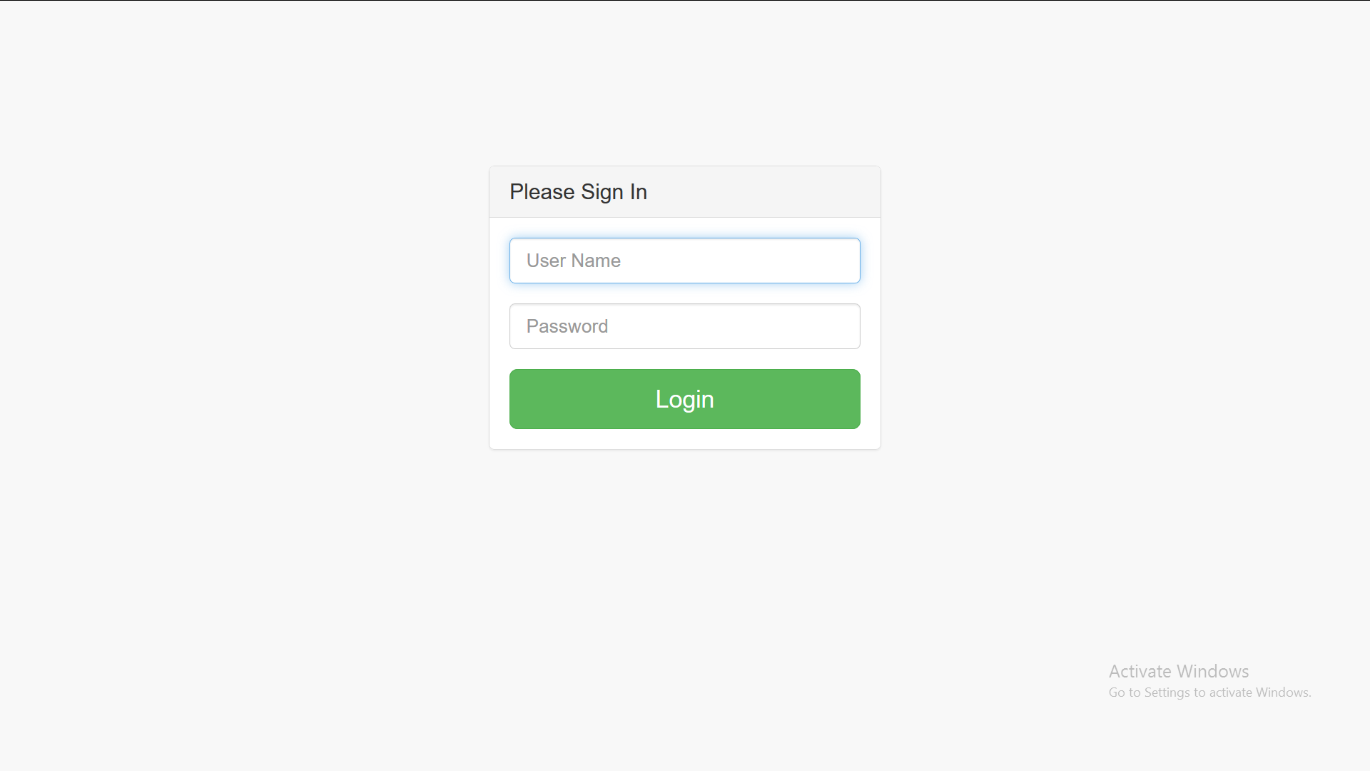
Admin Login Page

Slide 29
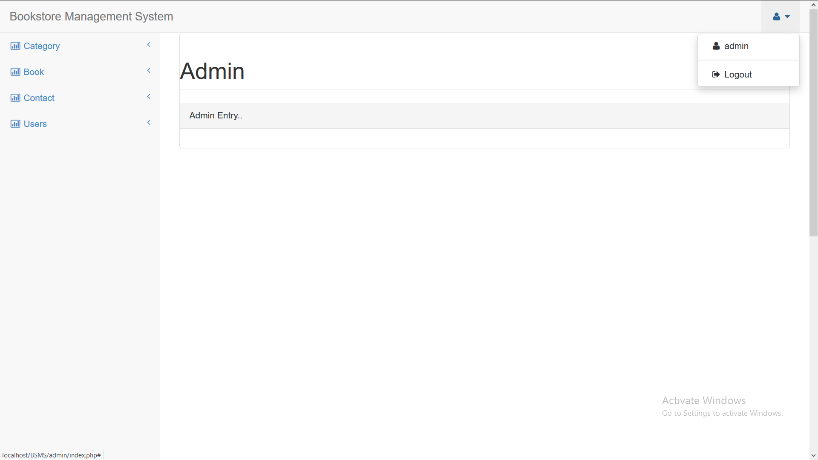
Admin Home Page

Slide 30
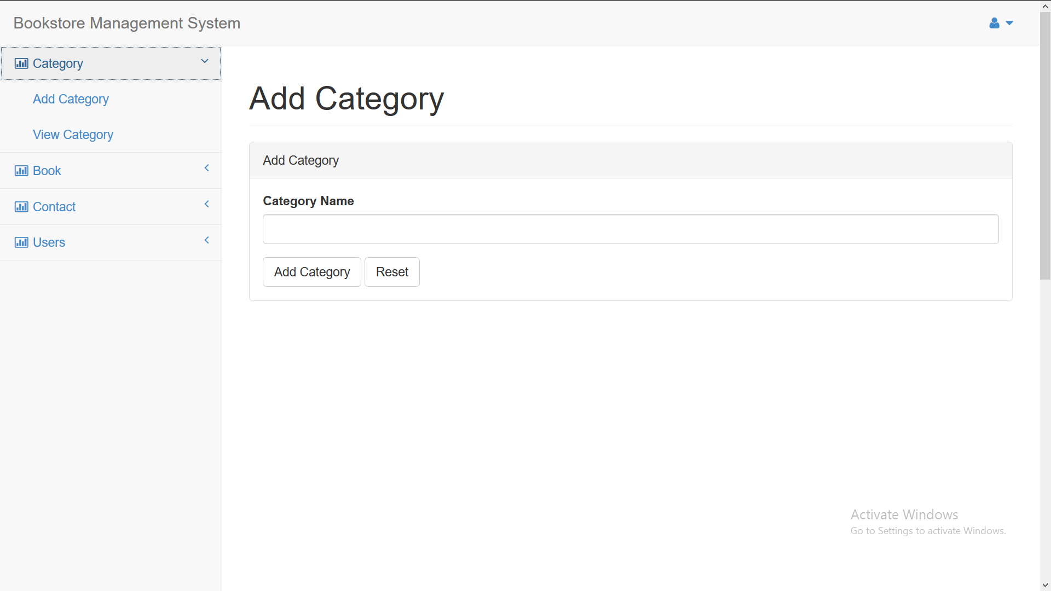
Add Category

Slide 31
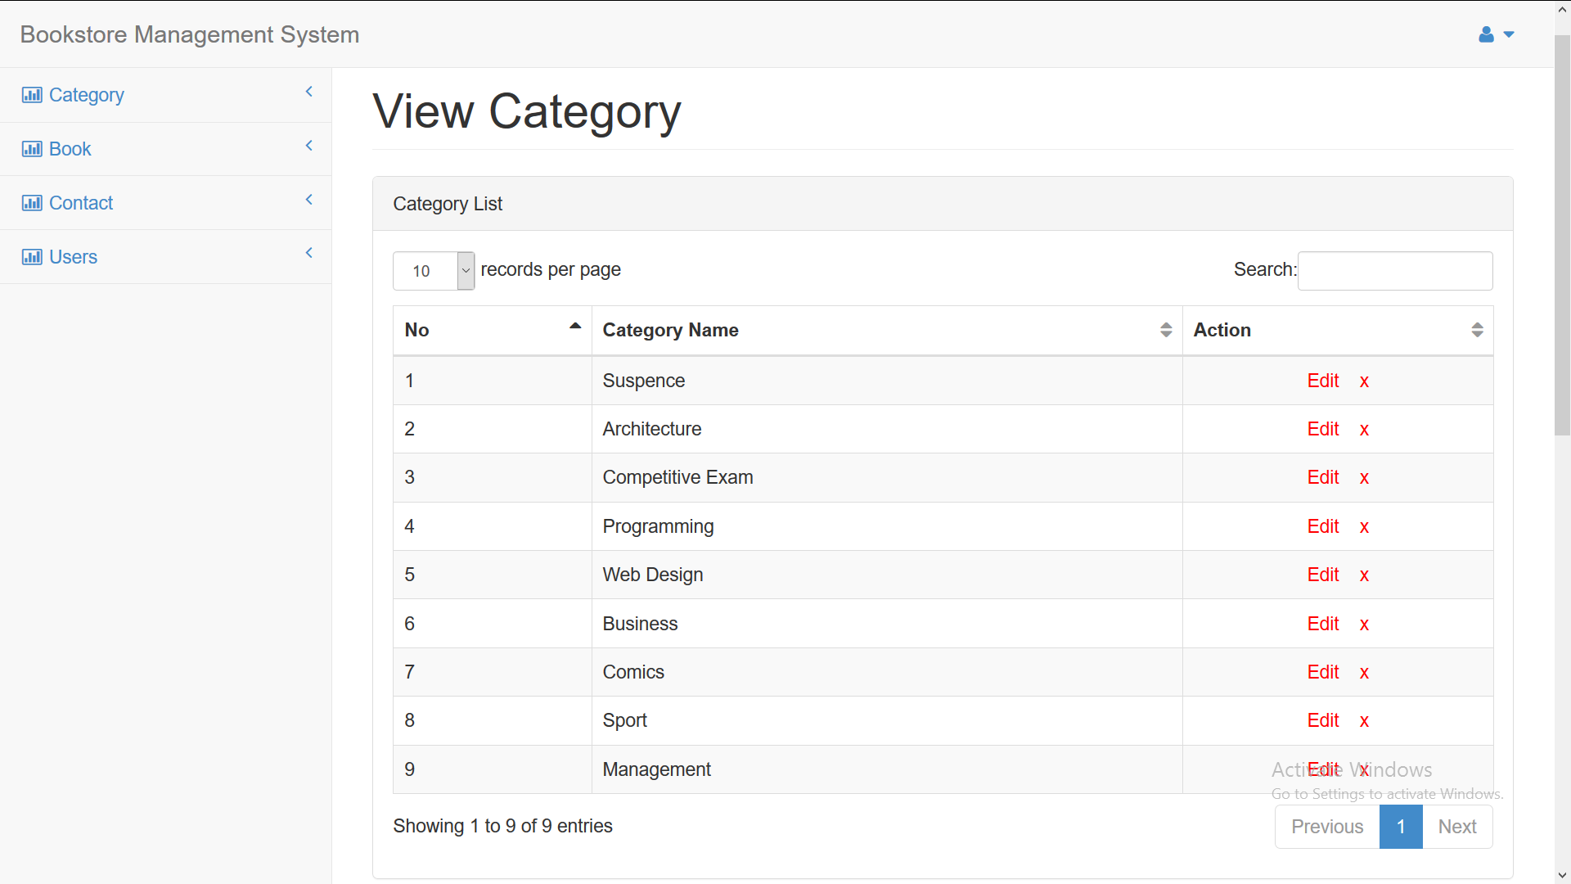
View Category

Slide 32
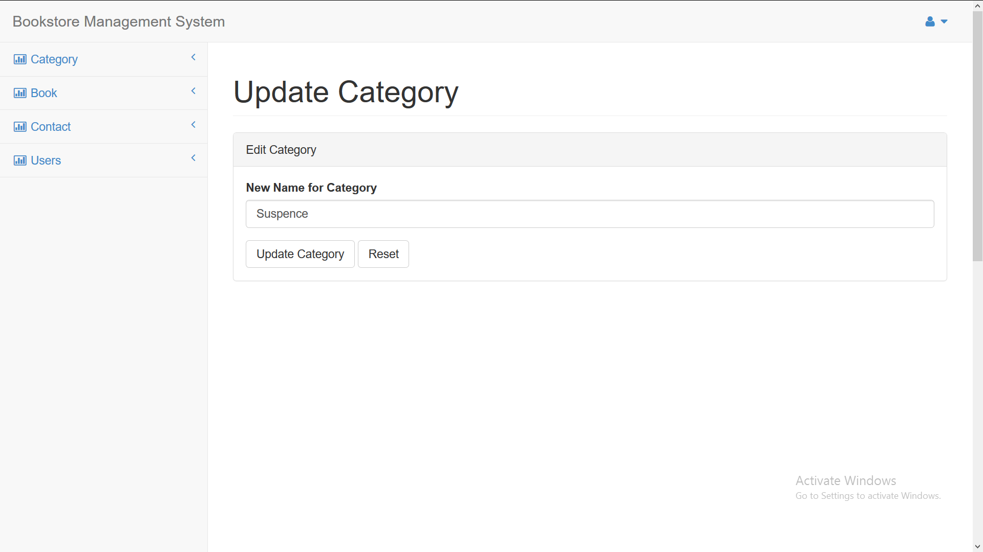
Edit Category

Slide 33
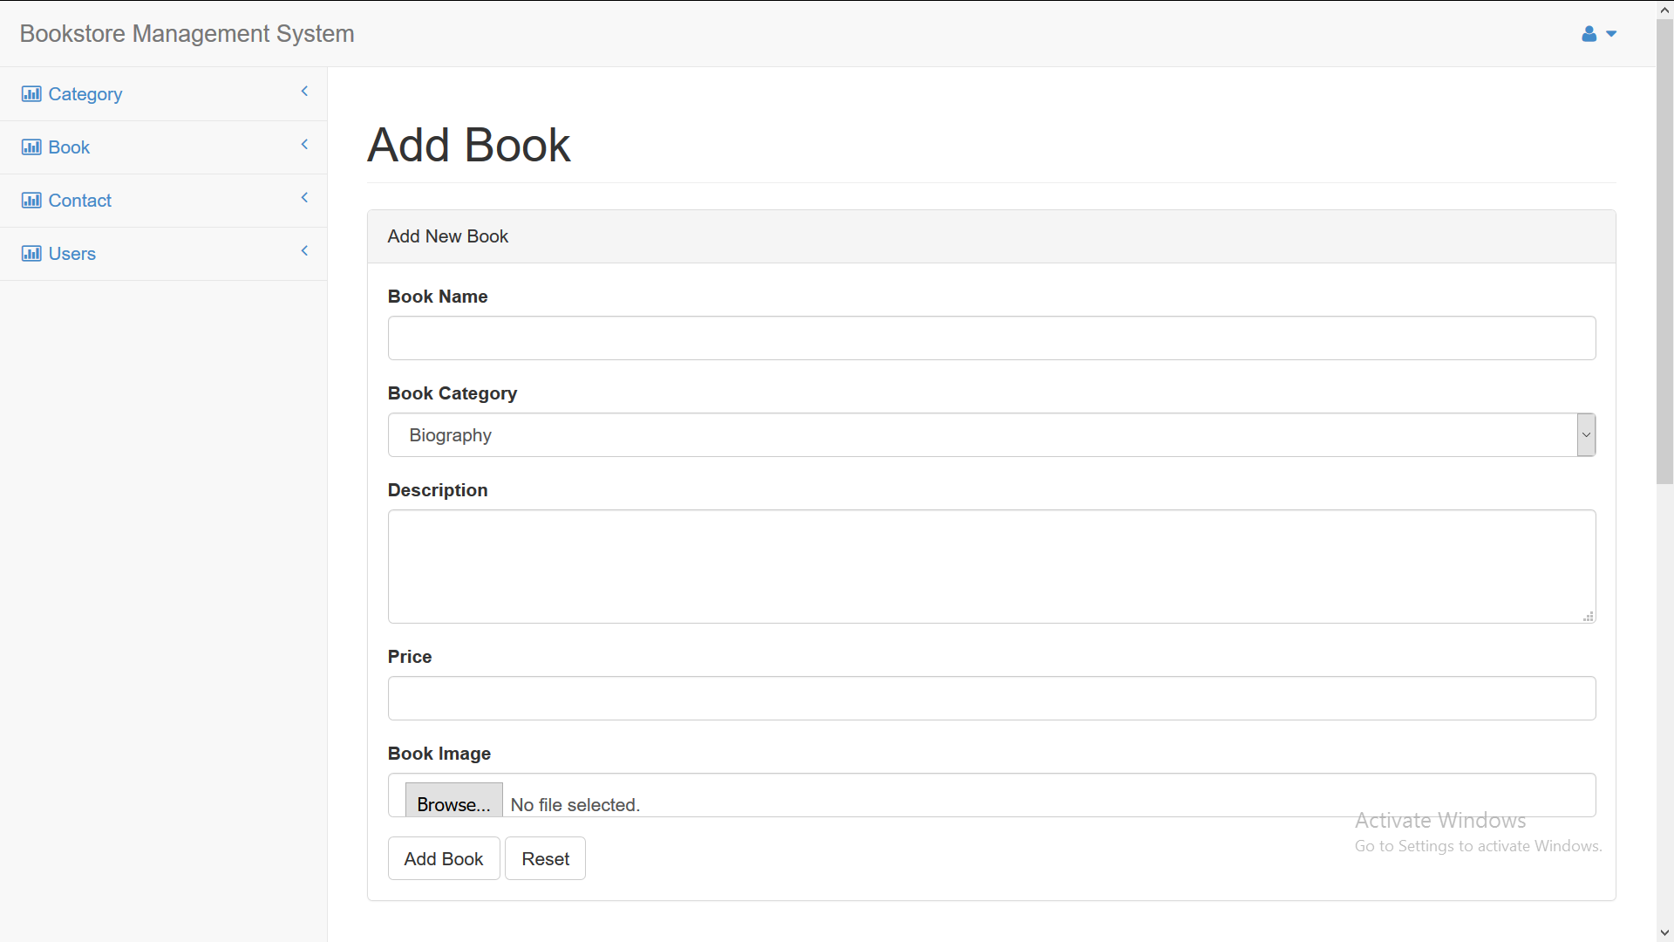
Add Book

Slide 34
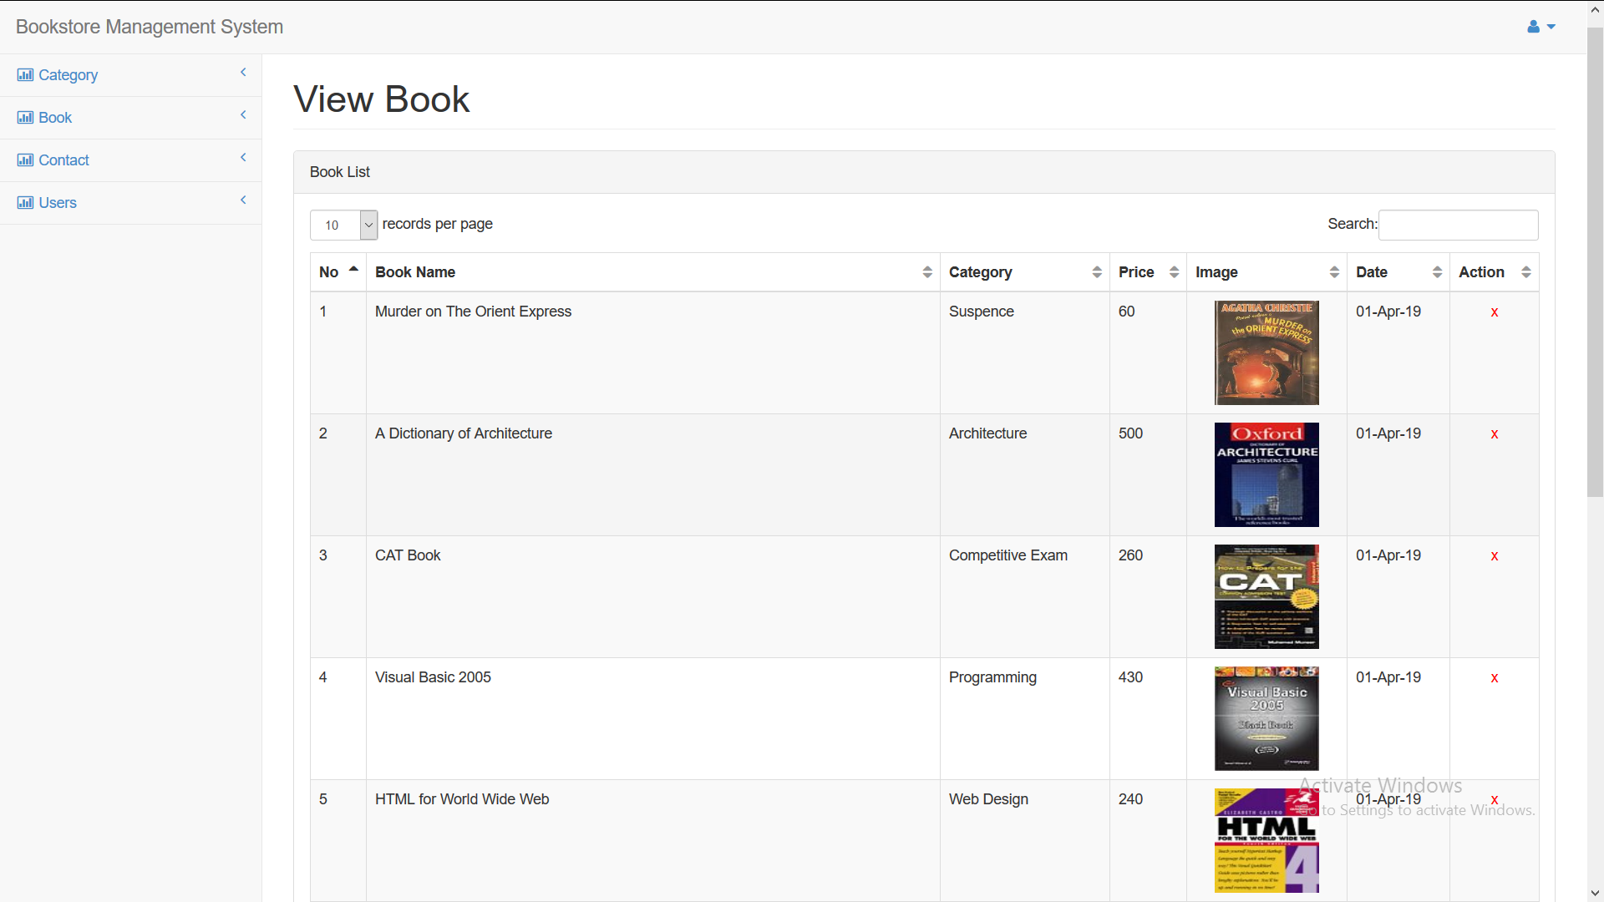
View Books

Slide 35
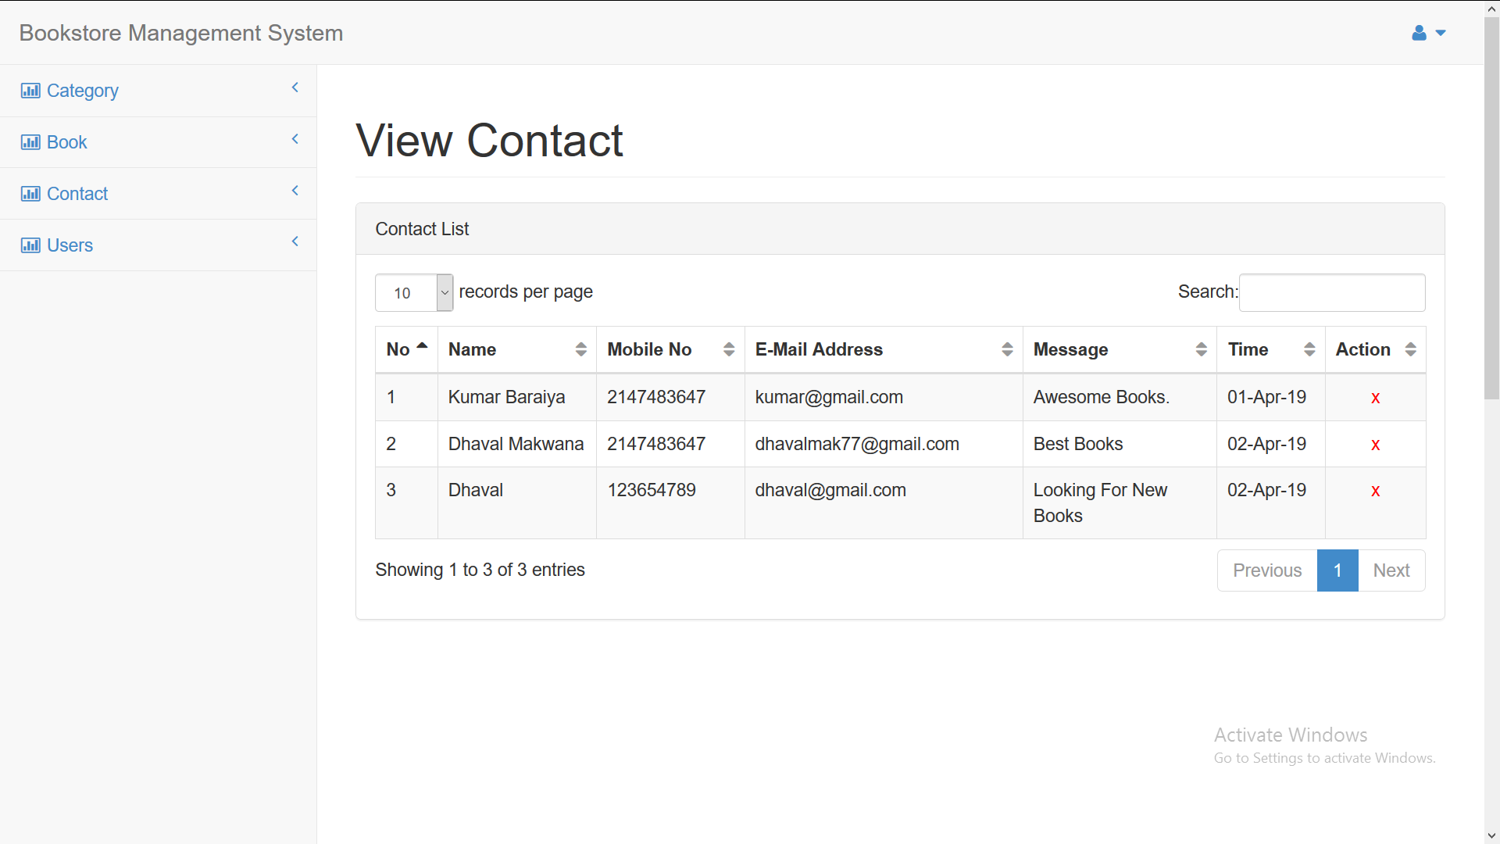
View Contacts

Slide 36
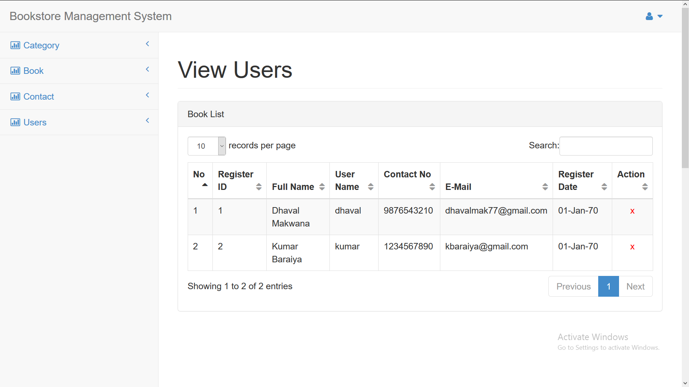
View Users

Slide 37
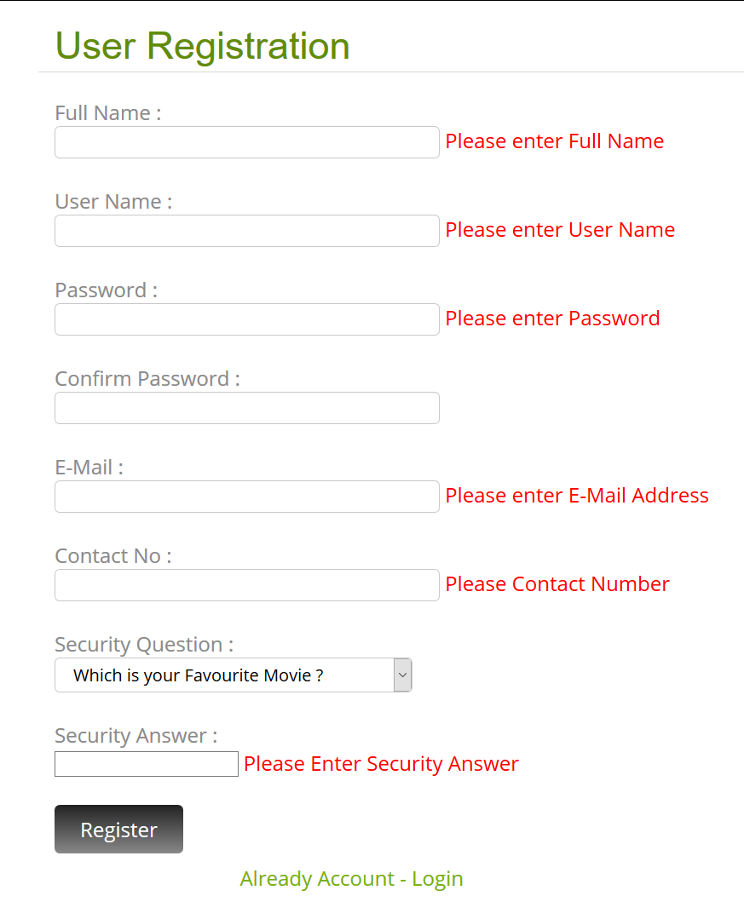
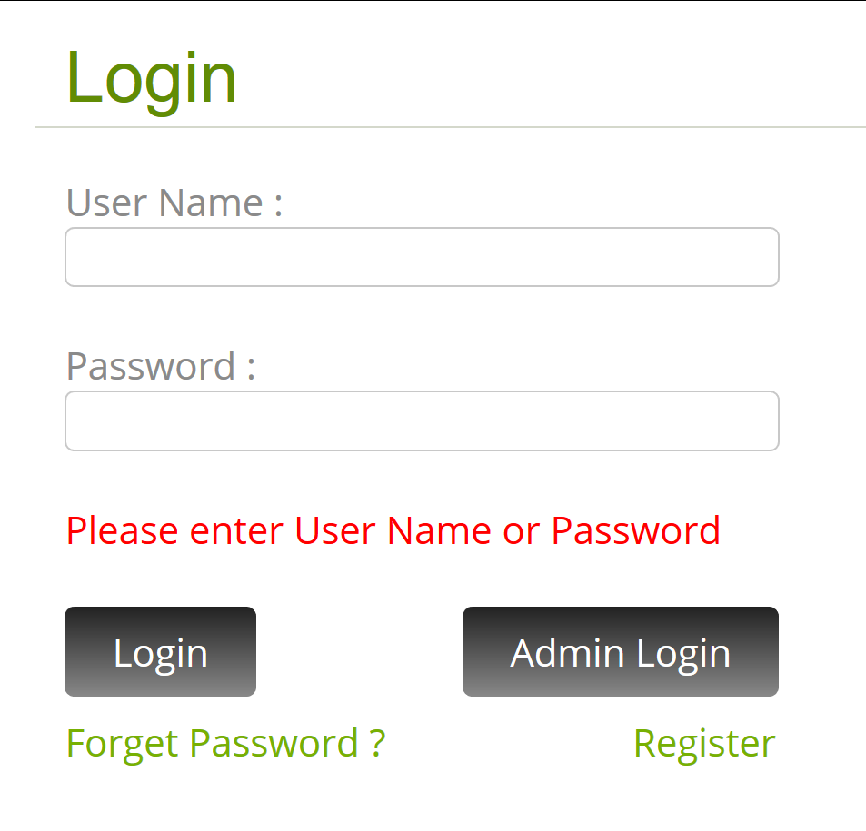
Empty Field Validation

Slide 38
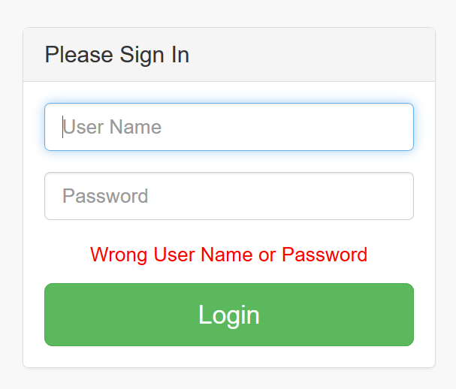
Wrong Details Validation

Slide 39
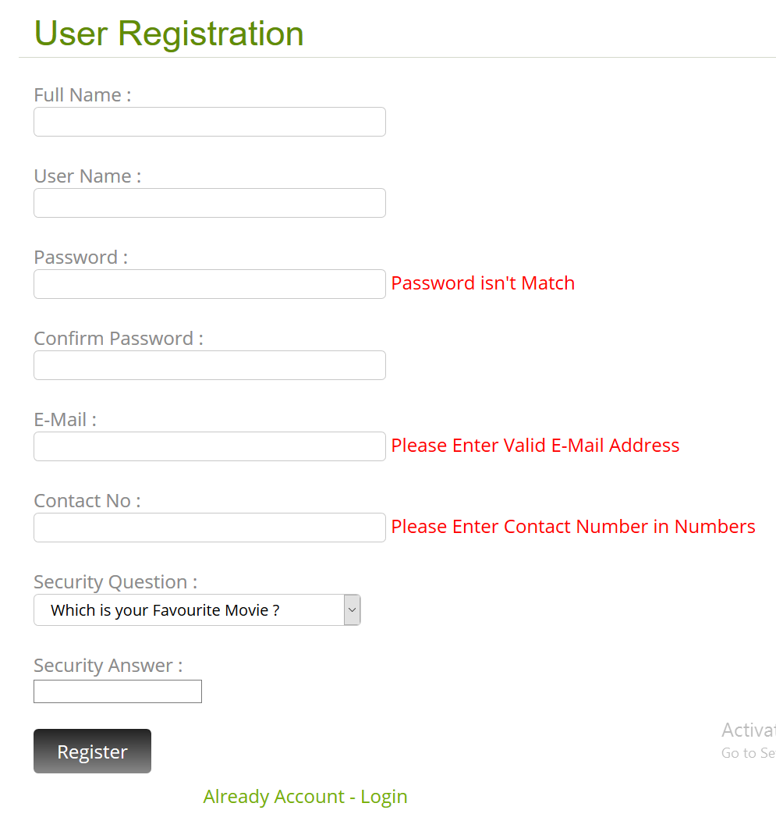
Password, E-Mail & Number Validations
Both Passwords aren’t Match
Password Contains: Minimum 8 Letters
Invalid E-Mail Address
Valid E-Mail Contains:
alphabets, numbers, @ and dot(.)
Contains Numeric Contact Number

Slide 40
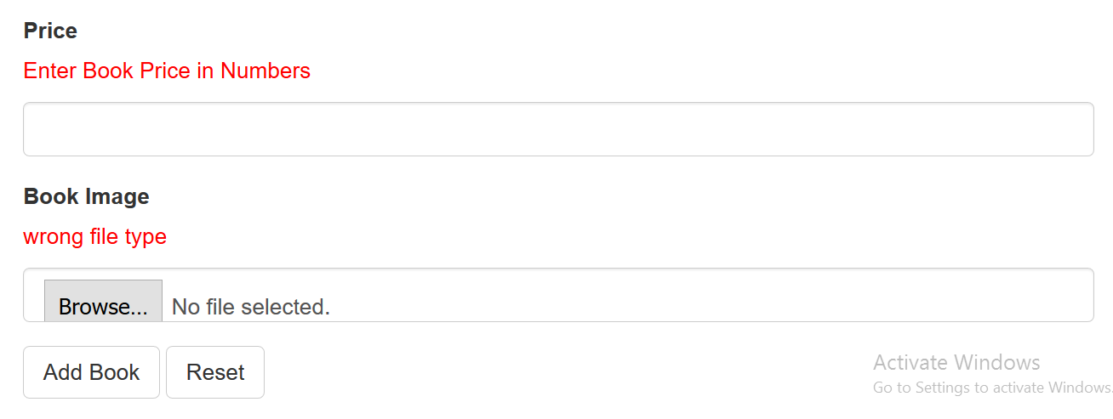
Number & Wrong File Validation
Contains Numeric Price
Contains Valid Extensions:
.JPG, .JPEG or .GIF

Slide 41
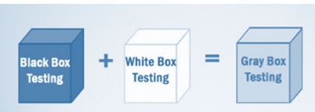
TESTING AND IMPLEMENTATION
Gray Box Testing
Gray-box testing is a testing technique performed with limited information about the internal functionality of the system. Gray box testers have access to the detailed design information about requirements.
Gray box are generated based on the state based modes, UML diagrams or of the target system.
Gray Box Testing is a technique to test the software product or application with partial knowledge of the internal workings of an application.

Slide 42
BIBLIOGRAPHY
https://www.google.com
https://www.youtube.com
https://www.w3schools.com
https://stackoverflow.com
https://www.quora.com
https://www.scribd.com
https://www.udemy.com

Slide 43
Thank you

